Slide 1


Slide 2

01
INTRODUCTION
The website will help the tourist decide which place to visit based on the reachability, accommodation, and other factors. Also it will provide the history form the Wikipedia.
The authors and bloggers will also will be able to request to publish their content with the link based along side the Wikipedia.
The administration of the author and blogger content will be done by the stake holders of the website

Slide 3
02
01
OBJECTIVE
The website will provide the tourist to plan and decide which place they want to visit as some people have time constraint and want to take a break , they can decide which place will suit them.
The authors will also find their article or blogs published.

Slide 4
03
REQUIREMENTS
System requirements
Operating system: mac OS, Windows operating system, chrome OS.
Screen: the screen should be wither 16:9 or 16:10.
Software: web browser.
RAM: System total be more the 4GB.
Languages and framework used used
Languages : HTML, CSS, JAVASCRIPT.
Framework : ANGULAR JAVASCRIPT(JAVASCRIPT based framework),
BOOTSTRAP(CSS based framework).

Slide 5
04
ENTITY RELATIONSHIP DIAGRAM
Article id
Spot id
User id
type
Entities
City
Tourist spot
User
articles
M:M
articles
sends
user
searches
M:M
M : 1
Includes article and blogs
City id
City name
1:M
city
have
Tourist spot
Spot id
Spot name
Spot type

Slide 6
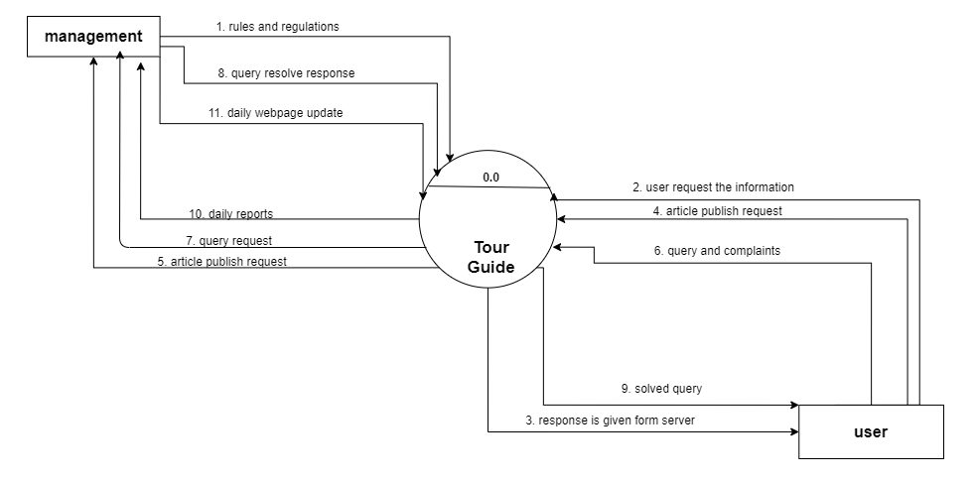
05
CONTEXT LEVEL DIAGRAM

Slide 7
06
DATA FLOW DIAGRAM
Master maintenance
management
Rules
1.0
Rules_master
Info on cities and places
City_master
User details
user
Place_master
Articles
Article_master
User_master

Slide 8
06
DATA FLOW DIAGRAM
Search
City detail
2.0
City_master
Searches for city
user
Search for place
place detail
Place_master

Slide 9
06
DATA FLOW DIAGRAM
feedback and query
Article post request
3.0
Article master
feedback
feedback
user
Query and complaint
Query and complaints
Management
Solution received
User master
solution
Article feature

Slide 10
06
DATA FLOW DIAGRAM
City_master
reports
4.0
Place_master
User_master
management
Rules_master
Article_master

Slide 11
07
USER INTERFACE

